Slide 1
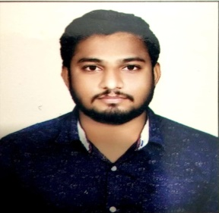

Competencies
Have thorough understanding of Java, AWS ,MuleSoft, Spring and Spring Boot. Ability to comprehend the Business Requirement, Design and proficient in using Anypoint Platform to discover, consume, build, deploy, manage, and govern APIs. Trained on Spring Framework. Good Knowledge of Spring framework Well versed in Agile Methodology . Hands on experience in building API-led and Connector-based integrations for end points like SAP, Salesforce, Files, Database etc. Analytical mindset and problem solving skills. Good communication skills and effective team player. Completed AWS Level 0 Certification. Good Knowledge of HTML & CSS.
Akash Jadhav
jadhav.akash-narahari@capgemini.com
7083643529
Mulesoft Certified Developer,
Bachelor’s Degree in Civil Engineering
Skills
Mule Soft 4.0
SQL,XML,JSON
AWS, HTML & CSS
Java
JDBC, Spring Boot
Mule Specifics
RAML
Exchange
Standard Connectors
API Manager
Runtime Manager
Anypoint MQ
Dataweave
Scheduler
Exception Handing
Logging
Experience
Hands-On assignment on mulesoft Working knowledge of exception handling and logging, in API-led distributed environment. Used Dataweave transformations to handle diverse set of message formats like JSON, XML, CSV, etc. Working knowledge of batch implementations, to synchronise data between Salesforce and business database. Worked on Design, Development and Deployment activities of Integration. Functional Testing for the deployed. Integration in IBM Web Management Console. Has extensive hands-on in XML, JSON (2.0 and 1.0) Worked on extensive Exception Handling use cases in App Connect 7.5.4 and 7.5.5.0.

